Slide 1
East Bridgewater 2024-2034 Master Plan
Discovery Workshop
Rhiannon Dugan, Senior Comprehensive Planner OCPC
rdugan@ocpcrpa.com

Slide 2
Today’s Agenda
Introductions
Master Plan Who, What and Why?
Current Data Collection and Maps
Turning it in to Elements
Your input: What do you enjoy about East Bridgewater? Where would you like to see change?

Slide 3
OCPC Collaboration
• Listen to the community
• Understand the community's goals and priorities for the town
• Gather, analyze, and present information
• Help make a plan that responds to your goals

Slide 4
What is a Master Plan?
In accordance with Massachusetts General Law:
Such plan shall be a statement, through text, maps, illustrations or
other forms of communication, that is designed to provide a basis for
decision making regarding the long-term physical development of the
municipality. The comprehensive plan shall be internally consistent in
its policies, forecasts and standards . . . [M.G.L. c. 41, s. 81D]
Long-term typically interpreted as a guide for the next 10 or more years

Slide 5
State Required Elements
State Requirements - M.G.L. c. 41, s. 81D directs Planning Boards to prepare a Master Plan
with the following chapters (aka “elements”):
Statement of Goals and Policies
Land Use
Housing
Economic Development
Natural and Cultural Resources
Open Space and Recreation
Sustainability and Climate Change
Services and Facilities
Transportation and Circulation
Implementation Strategies

Slide 6
What does a Master Plan mean for a town?
A guide for local public policy
Bylaws
Land preservation
Targeted economic development
Prioritize conservation areas
Allocate funds for capital improvements
Advocate for needed services
Capture the wants and needs of the community

Slide 7
What type of information do we look at?
Land Use Patterns
Zoning and Bylaws
Town Priority Areas
Municipal Land and Facilities
Water Resources
Conservation
Wildlife Habitat
Agriculture
Transportation
Emergency Statistics and Services
Land Values
History
Demographics
Economy

Slide 8
And your input!
The community’s character, input, and goals are the most important part to make the plan unique and effective.
Public Workshops (Today and more to come)
Table Events
Website and Social Media
Public Comment Submissions
Master Plan Committee

Slide 9
Timeline
Summer 2023
Demographic Research
Fall 2023
Ongoing outreach and Survey launch
Winter 2023
Plan Writing and Public Meetings
Spring 2024
Public Review

Slide 10
Data

Slide 11
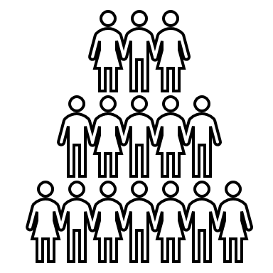
Demographics

Slide 12
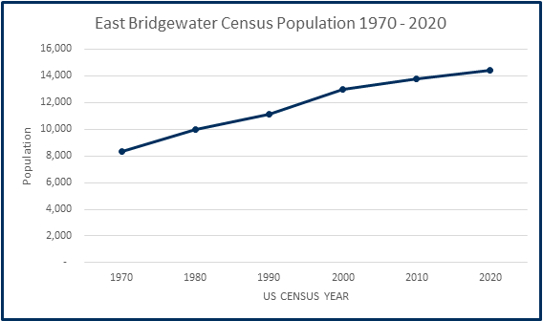
Population Trends
Between 2000 and 2010, the town population increased by 820 residents (6.32%). In the decade 2010 through the 2020 Census, the town gained 646 residents, a 4.68% increase according to the 2020 Census bringing the total population to 14,440.

Slide 13
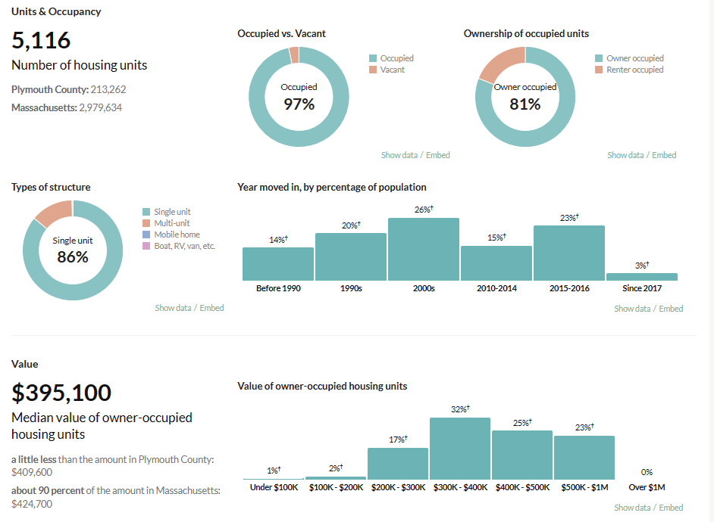
Housing

Slide 14
Housing: Subsidized Housing Inventory
10% of each town's housing stock in Massachusetts must be subsidized units.
At this time, only 176 of 5,186 housing units are subsidized totalling 3.39% .
How can the town diversify its housing stock?
What types of houses does current zoning support?
Notes:
Add in cost burdened

Slide 15
Education Needs
Table 40: School Enrollment by Grade, 2022 - 2023
Source: Enrollment Data (2022-23) - East Bridgewater (00830000) (mass.edu)

Slide 16
Income

Slide 17
Local Economy
Company name | Number of employees
East Bridgewater YMCA | 100-249
Harte-Hanks Inc | 100-249
Mueller Corp | 100-249
Villa At Ridder Country Club | 100-249
VK East Bridgewater LLC | 100-249
World Publications Group Inc | 100-249
Central School | 50-99
Club Ex Fitness & Nutrition | 50-99
D W Clark Co | 50-99
Public Schools and municipal jobs combined, East Bridgewater is the largest employer of the town.
Cont.
Company name | Number of employees
East Bridgewater Jr/Sr High | 50-99
East Bridgewater Middle School | 50-99
East Bridgewater Town | 50-99
Notes:
EOLWD employment by industry top town employers Mass DLS Tax Base

Slide 18
Local Economy
Fiscal Year​ | Residential Levy​ | Open Space Levy​ | Commercial Levy​ | Industrial Levy​ | Personal Property Levy​ | Total Levy​ | CIP Levy as a % of Total​
2023​ | 30,752,618​ | 0​ | 1,794,081​ | 947,803​ | 741,544​ | 34,236,046​ | 10.17​
Commercial and Industrial Levy help reduce the pressure of residential taxes. Increased revenue to the town allows for capital improvement.
Where in town would residents support more business? What businesses would the residents support?
Notes:
EOLWD employment by industry top town employers Mass DLS Tax Base

Slide 19
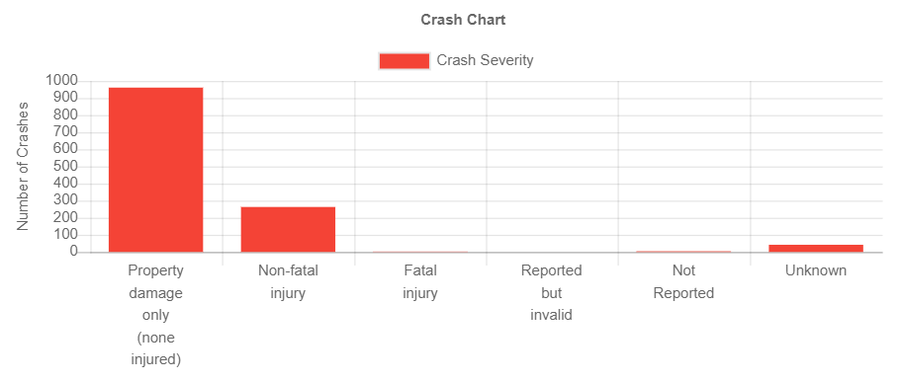
Transportation
Accidents in town from 2020-2023

Slide 20
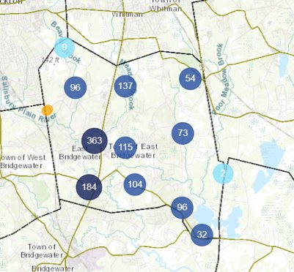
Transportation
Where in town are most accidents occurring?
Are there spots in town you don't feel safe as a driver or pedestrian?
What intersections cause the most concern for the town?

Slide 21
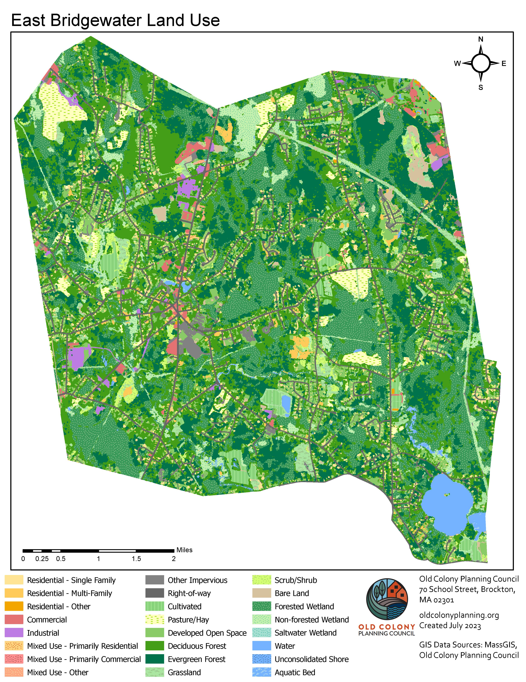
Zoning and Land Use Maps

Slide 22
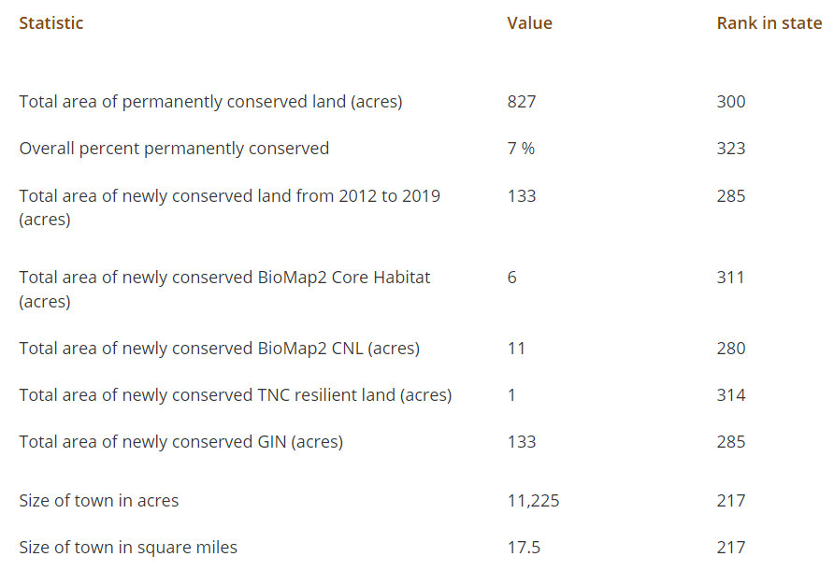
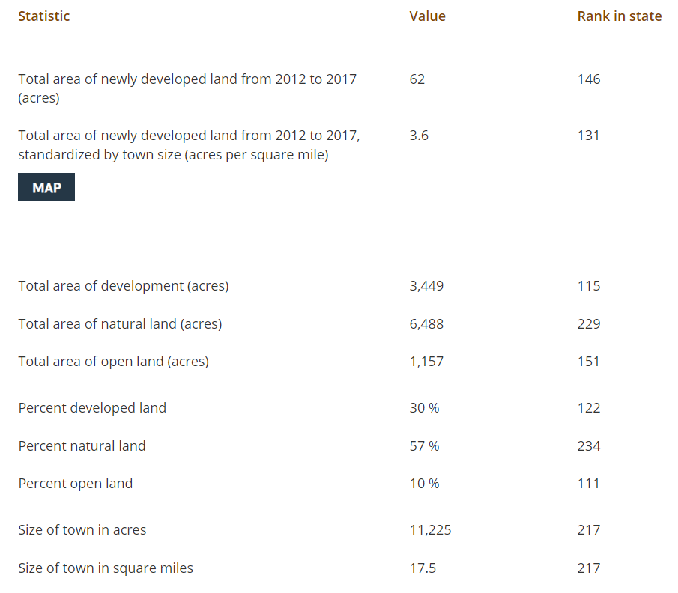
Conservation
The following statistics are from the Losing Ground 2020 report by Mass Audubon. The numbers reflect the values and change in land use between 2012 and 2017. These numbers may have changed since.
Mass Audubon uses multiple data sources to compare each of the 351 town and city's conservation land.

Slide 23
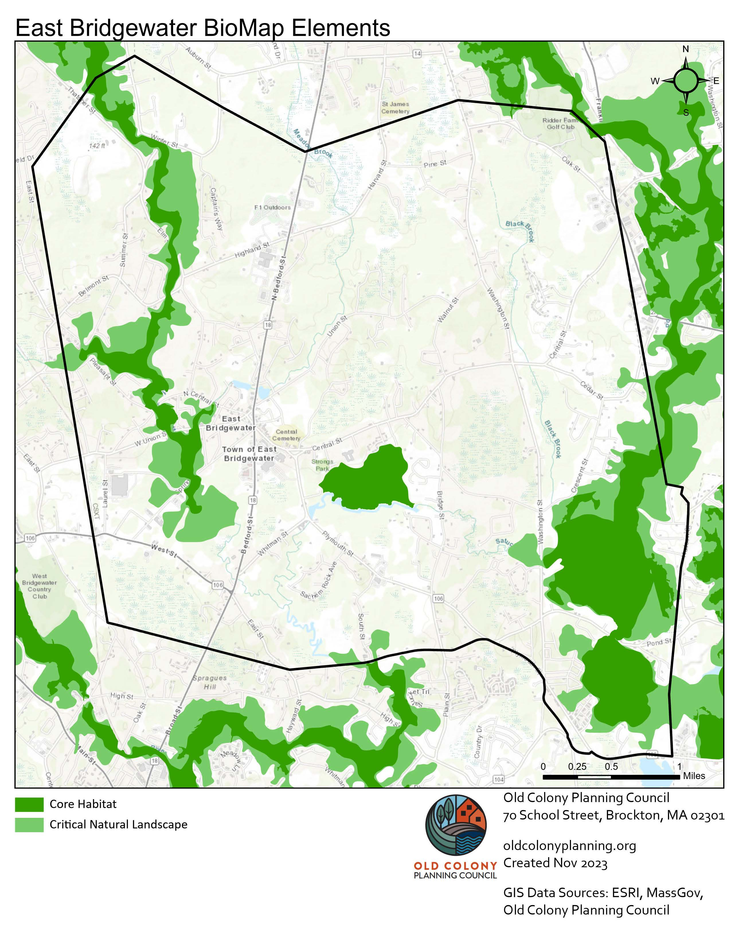
Significant Habitat Areas from BioMap 2022

Slide 24
How does this become chapters?
Data
Engagement
Plan
Looking at the data presented here, previous planning efforts from the town and your engagement we determine where the town is thriving and where the town wants to improve! Using this, we create goals for the town to work towards over the next 10 years.

Slide 25
Stay engaged with the process!
Take the survey
Explore the website
Comment on the plan
Contact us!

Slide 26
Provide your input!
Look at maps up close and share your thoughts with staff
Write your thoughts about the town on posters
For those joining on zoom, digital access is being provided for this activity.
https://miro.com/app/board/uXjVN7NpdTk=/

Slide 27
Thank you for your time!
Contact us!
Rhiannon Dugan
Senior Comprehensive Planner OCPC
rdugan@ocpcrpa.org
Charlie Seelig
Town Administrator
https://oldcolonyplanning.org/east-bridgewater-master-plan/
cseelig@eastbridgewaterma.gov

